Slide 1

Airbnb Hotel Booking Analysis
Bala Praharsha Mannepalli
INTERNSHIP_17546440516895be537820f

Slide 2

PROBLEM STATEMENT
Airbnb has transformed the hospitality industry by connecting travelers with unique lodging options. However, with thousands of listings across cities, hosts face challenges in optimizing pricing, availability, and guest satisfaction, while Airbnb aims to enhance user experience and platform efficiency.
This project seeks to analyze Airbnb booking data to uncover patterns in property types, pricing strategies, host behavior, and guest preferences, providing actionable insights for both hosts and the platform.

Slide 3
Project Description [write detail description of your project ]
Analyze Airbnb booking data to uncover patterns in property types, pricing, and guest behavior.
Examine host behavior: verification status, listing counts, and availability.
Explore pricing trends and the relationship between property features and price.
Evaluate guest satisfaction through review ratings across room types and neighborhoods.
Study service fee trends and correlation with listing prices.
Provide actionable insights for hosts to optimize listings and improve guest experience.

Slide 4

WHO ARE THE END USERS?
- Airbnb Hosts:
Individual property owners and professional hosts.
Use insights to optimize pricing, availability, and property performance.
- Airbnb Platform:
Leverages data to enhance user experience and improve platform efficiency.
- Guests / Travelers:
Benefit indirectly from better property availability, pricing transparency, and improved service quality.
- Market Analysts / Researchers:
Can use findings to understand trends in short-term rental markets.

Slide 5

Technology Used
Python: For data cleaning, analysis, and visualization.
Pandas & NumPy: Data manipulation and statistical calculations.
Matplotlib & Seaborn: Graphical visualizations and plots.
Jupyter Notebook / Google Colab: Interactive coding and analysis environment.
Airbnb Open Data: Source of booking and listing information.

Slide 6
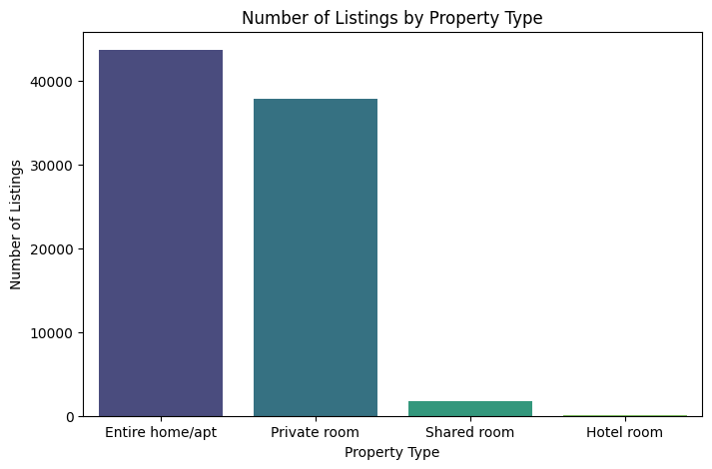
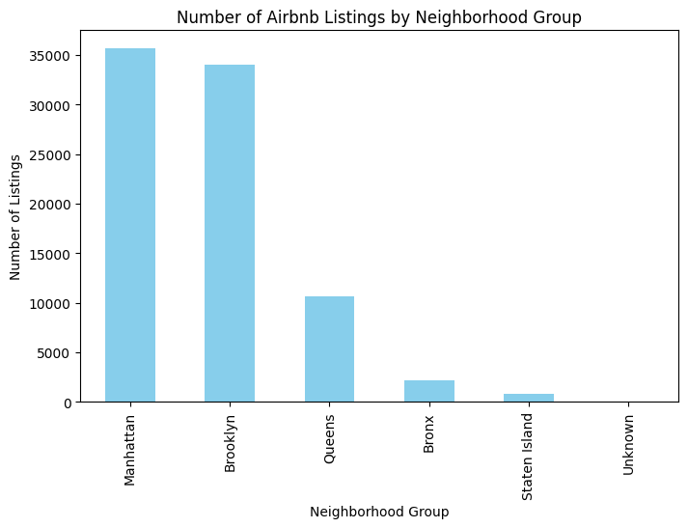
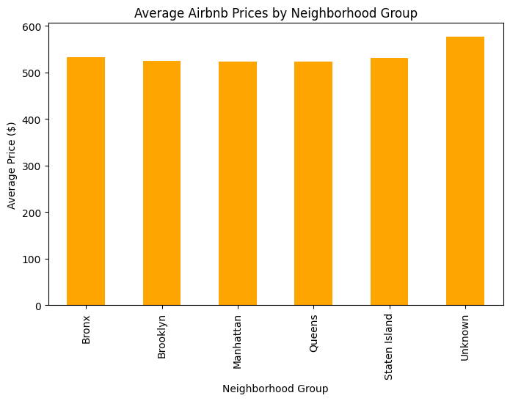
RESULTS1

Slide 7
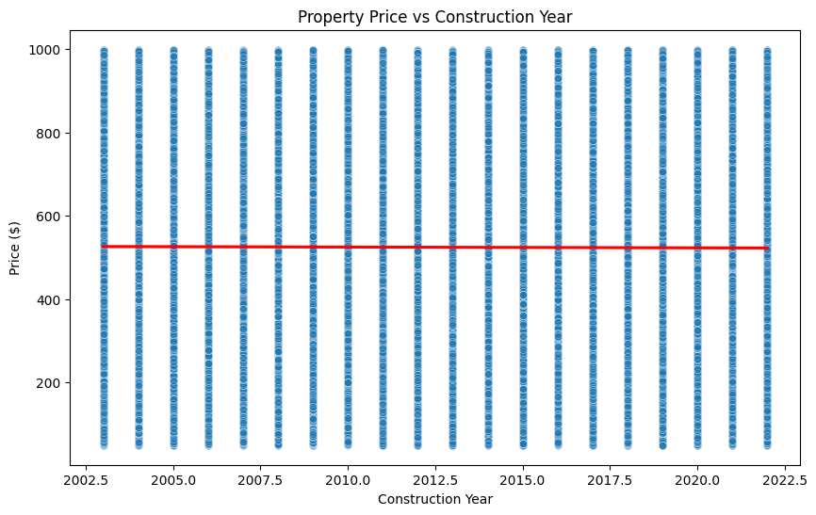
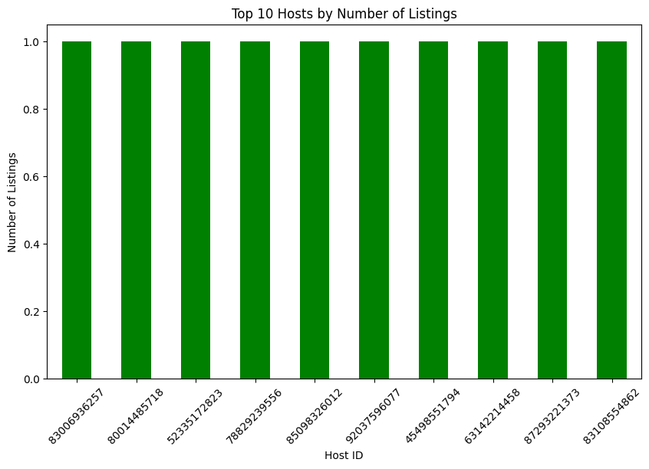
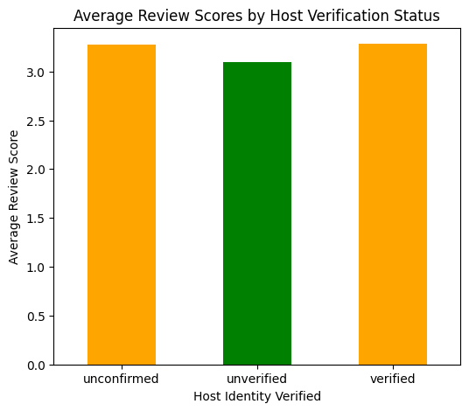
RESULTS2

Slide 8
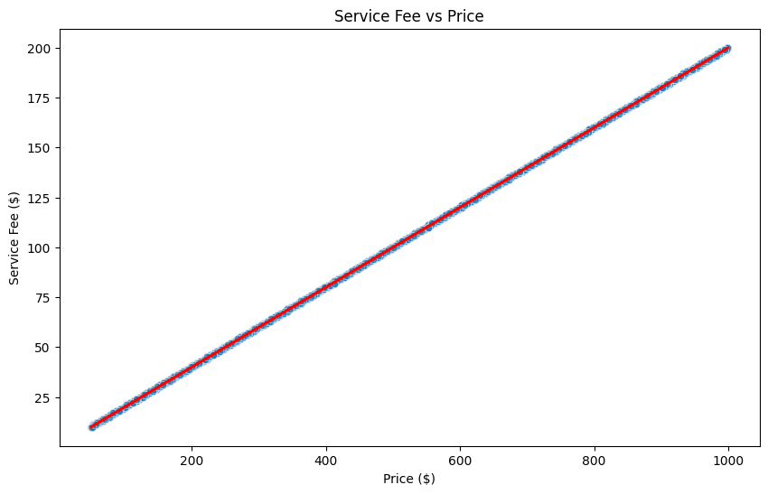
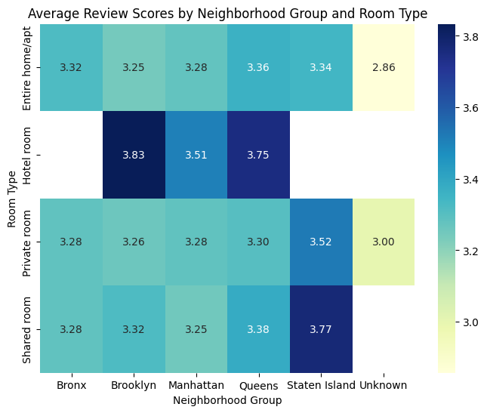
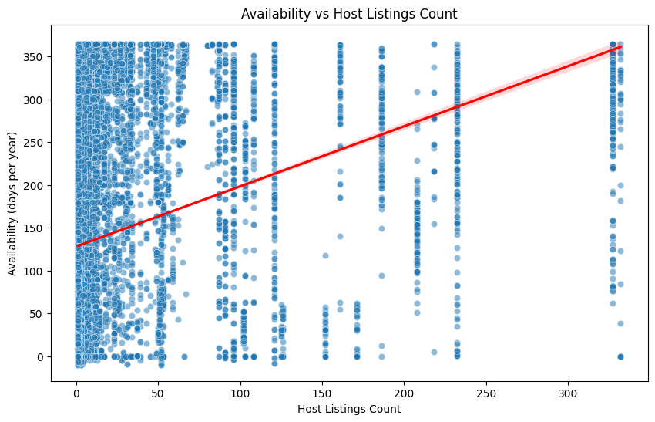
RESULTS3

Slide 9
GitHub repository
https://github.com/balapraharsha/VOIS_AICTE_Oct2025_BalaPraharshaMannepalli

Slide 10
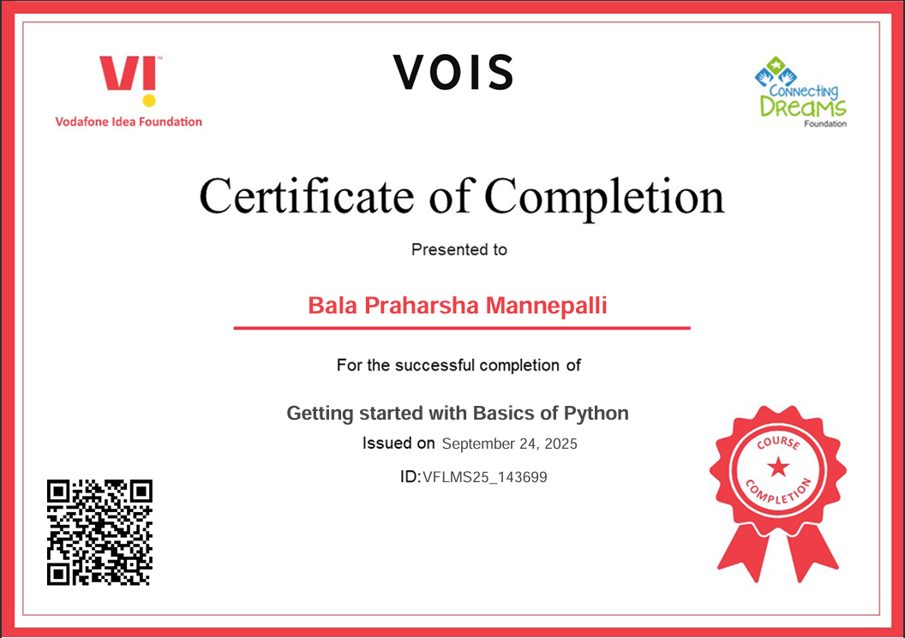
Getting started with Basics of Python Certificate

Slide 11
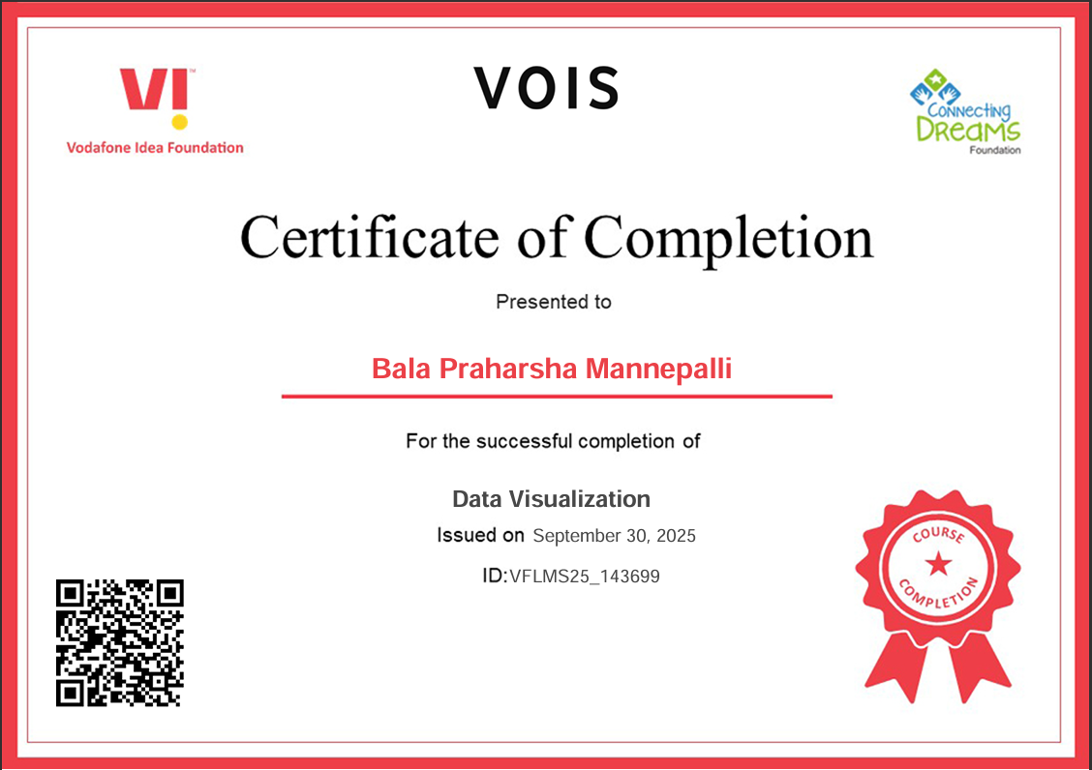
Data Visualization Certificate

Slide 12
Thank you
.
.

